Slide 1
Case study for Tasty Bytes
Yuyin Lang
2022.12.19

Slide 2
Outline
Introduction
Project overview
Business goal
Relevant work
Data processing
Model evaluation
Key findings
Recommendation

Slide 3
Introduction
Project overview
Given the information of recipes, predict whether it is popular
Information includes recipe category and nutritional composition
Business goal
Categorize the recipes correctly as much as possible
Specific criterion: 75% accuracy for low scoring recipes

Slide 4
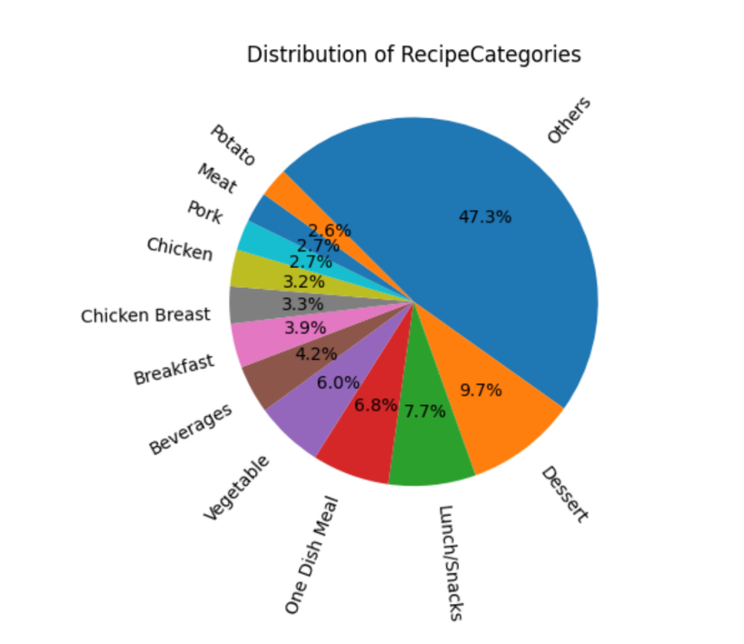
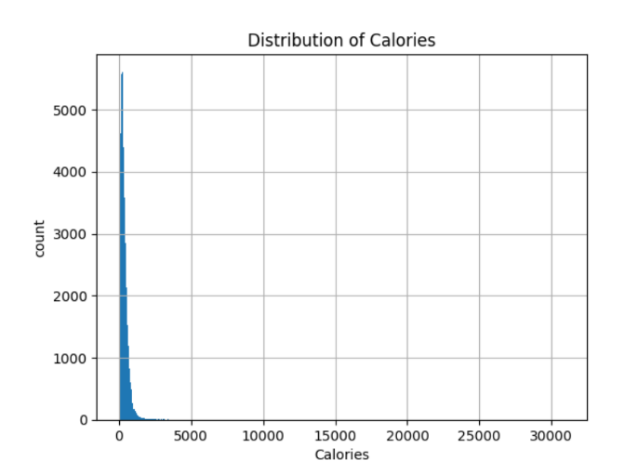
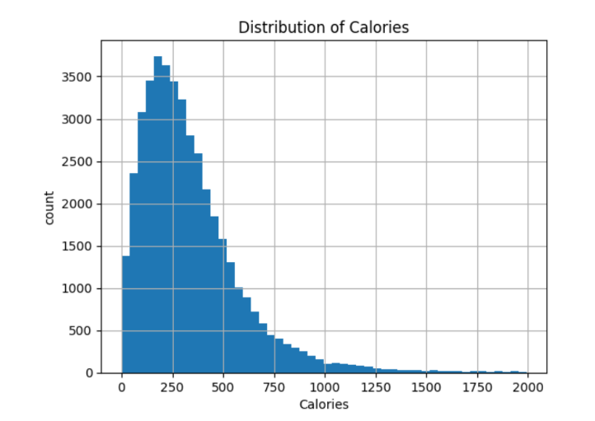
Data processing
1. Split the dataset
Meal
Ingredients
Others
2. Delete outliers
Only 1.5% of the data are deleted
Before:
After:

Slide 5
Model evaluation
 |  | Logistic Regression | Neural Network
Split 1 | Accuracy | 0.548 | 0.534
 | Precision | 0.526 | 0.835
 | Specificity | 0.570 | 0.232
Split 2 | Accuracy | 0.558 | 0.512
 | Precision | 0.556 | 0.496
 | Specificity | 0.560 | 0.529
Split 3 | Accuracy | 0.554 | 0.541
 | Precision | 0.610 | 0.619
 | Specificity | 0.499 | 0.464
Note:
Split 1: Meal
Split 2: Ingredients
Split 3: Others

Slide 6
Key findings
Overall, the performance is not as expected
About 0.55 for logistic regression and 0.53 for neural network
Neural network model for split 1 scored 0.84 for precision, which means it achieved 0.84 accuracy for all high scoring recipes.
Comparison to business goal
None of the model achieved specificity of 0.75 (same as accuracy for all low scoring recipes)
Result analysis
Better to evaluate the model on both precision and specificity

Slide 7
Recommendation
Refine the model
More information for training?
Possible information: Who designs the recipe (famous or not)? Who cooks the meal? Investigation about what the locals like…
For the existing meal, try to ask customers to rate and comment.

Slide 8
Questions?

